Slide 1

THE KRUSTY KRAB FOOD ORDER & DELIVERY WEBSITE Created by: Prashant Sarwan Lalit Bisht Subham

Slide 2
Specification of the project:
THIS IS A WEBISTE OF FOOD ORDER AND DELIVERY ! THE NAME IS “THE KRUSTY KRABS”
THE MAJOR SPECIFICATION OF THIS WEBSITE !
USER CAN ORDER THEIR FAVOURITE FOOD EASILY
USER CAN LOGIN/SIGNUP TO THE WEBSITE IN JUST FEW SECONDS WITH JUST SIMPLE STEPS
USER CAN FIND THEIR FAVOURITE FOOD ESILY WITH QUICK ACCESS FILTERS
USER’S DATA(SUCH AS: USER DETAILS, USER ORDERS) STORE TO BACKEND VERY SMOOTHLY WITHOUT ANY GLITCH
THERE IS FETURE OF CART IN THE NAVBAR WHERE MULTIPLE ORDERS CAN STORE AND THEN SHOW THE TOTAL AMOUNT USER HAVE TO PAY!
WE PROVIDE THE MULTIPLE OPTIONS FOR THE USER TO PAY EASILY (SUCH AS : cod(CASH ON DELIVERY), CREDIT/DEBIT CARDS ETC..)

Slide 3
Technology stack:
Html
Css
Javascript
React js
Node js
MongoDB
Express

Slide 4
Frontend:
we used the technologies in frontend are as follows :
For structure :
HTml
For styling :
Css
For logic and adding functionalities :
Java script
For rendering the all components of the project together on the web :
rEact js

Slide 5
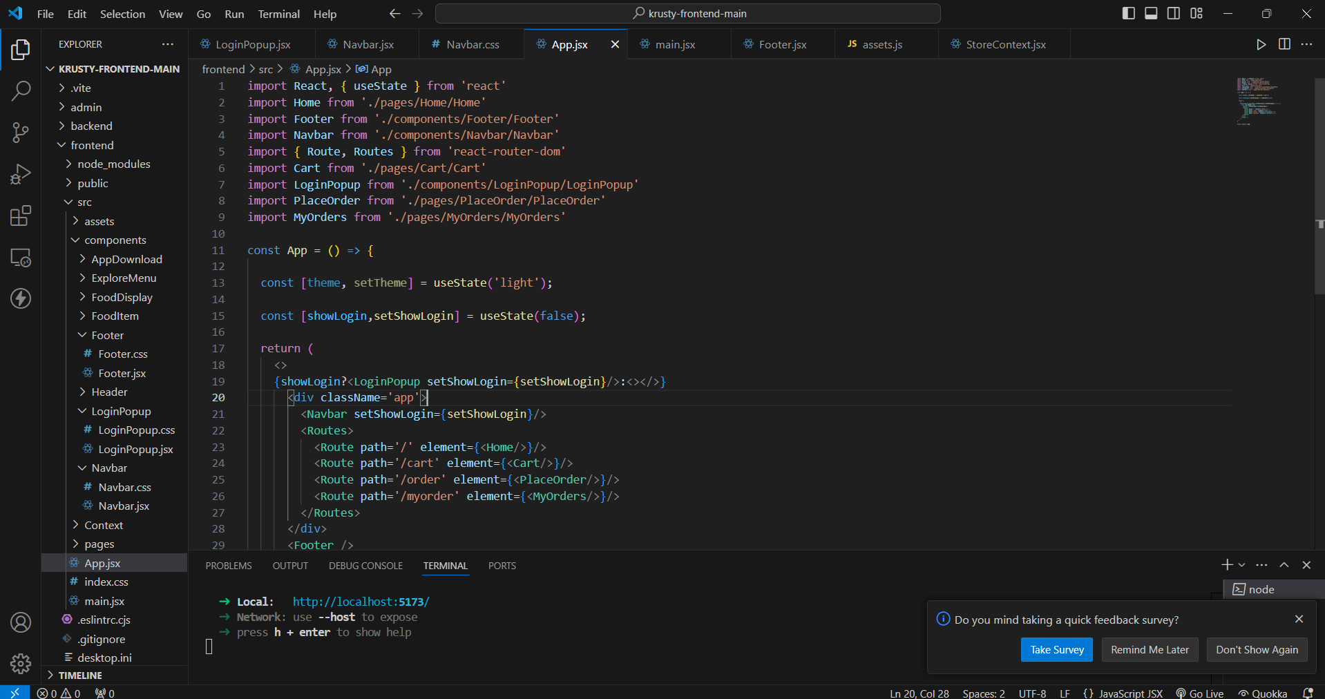
Source code of Frontend:

Slide 6
Backend:
we used the technologies in Backend are as follows :
To create server-side logic, handle HTTP requests :
Node js
to build and manage server-side applications and APIs :
Express js
To create the database for store the data :
MongoDB

Slide 7
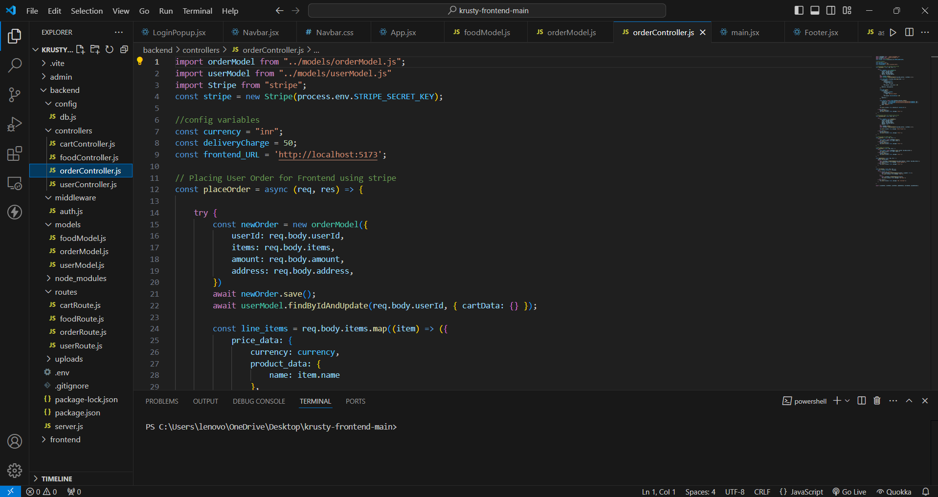
Source code of Backend:

Slide 8
Admin panel:
we used the technologies in admin panel are as follows :
Admin panel provide user interface to share food item from frontend to backend using API’s
Admin page provide user interface to show the data of delivery status and we can change accordingly
Why using admin panel ? We can add data food item and remove food item

Slide 9
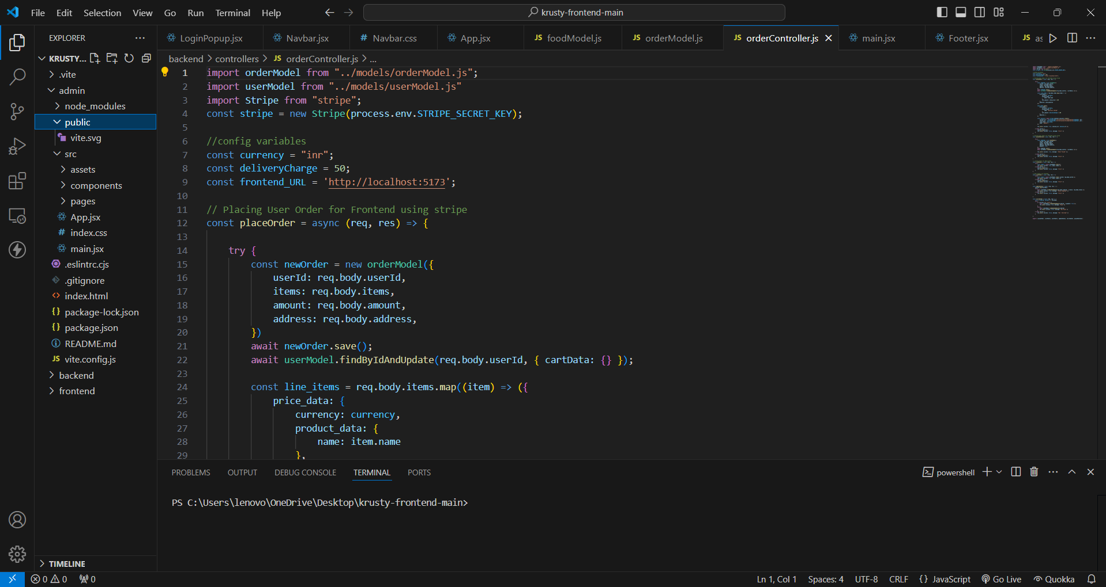
Source code of Admin panel:

Slide 10
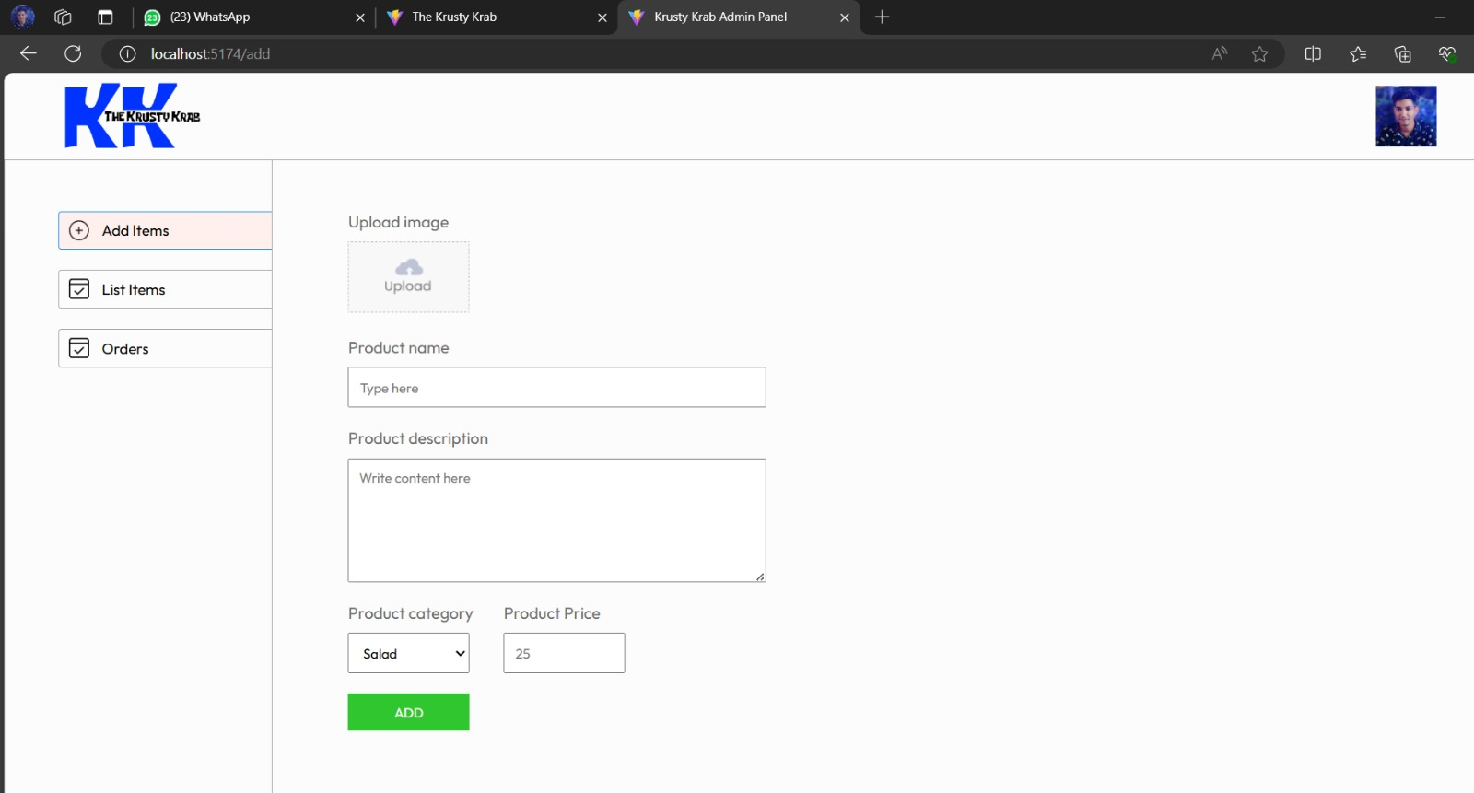
Output of Admin panel:

Slide 11
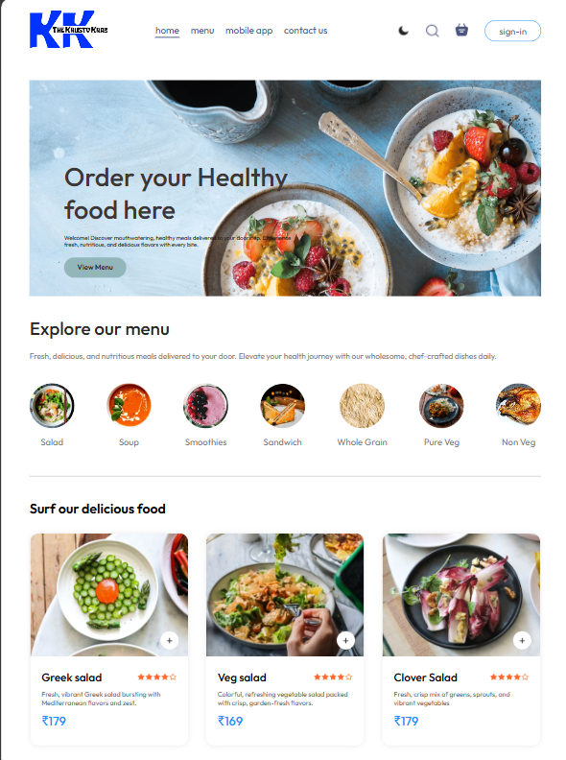
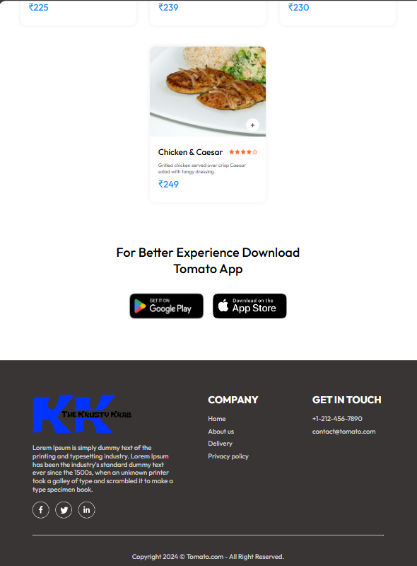
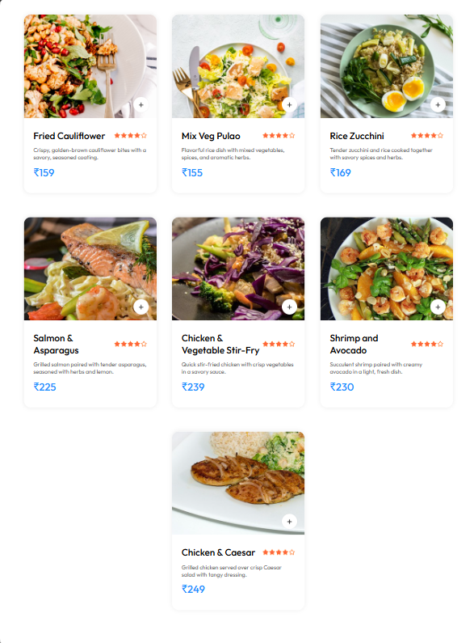
Output:

Slide 12
Problems our team face during the development of the website :
Complex Setup : Configuring MongoDB, Express, React, and Node.js.
State Management : Managing state in React, especially with complex interactions like cart updates and user authentication.
API Integration : ensuring proper communication between the frontend and backend, were challenging.
Database Design : Structuring the MongoDB database schema effectively to handle different data types and relationships (e.g., users, orders, and food items).

Slide 13
thank you
The krusty krab
888-xxxx-283
theKrustyKrab@gmail.com
www.thekrustykrab.com

